Slide 1
Lecture Title: Recursion (Cont.)
Course Code: CSC 2211
Course Title: Algorithms
Dept. of Computer Science
Faculty of Science and Technology
Lecture No: | 04 | Week No: | 04 | Semester: | Spring 20-21
Lecturer: | Name: Mushfiqur Rahman; E-mail: mushfiqur@aiub.edu

Slide 2
Lecture Outline
Divide and Conquer (Previous Week)
Recurrences in Divide and Conquer and methodologies for recurrence Solutions (Previous Week)
Repeated Backward Substitution Method (Previous Week)
Recursion Tree
Master Method

Slide 3

Master Method
The idea is to solve a class of recurrences that have the form
T(n) = aT(n/b) + f(n)
Assumptions: a ≥ 1 and b > 1, and f(n) is asymptotically positive.
Abstractly speaking, T(n) is the runtime for an algorithm and we know that
  a number of subproblems of size n/b are solved recursively, each in time T(n/b).
  f(n) is the cost of dividing the problem and combining the results. e.g., In merge-sort .

Slide 4
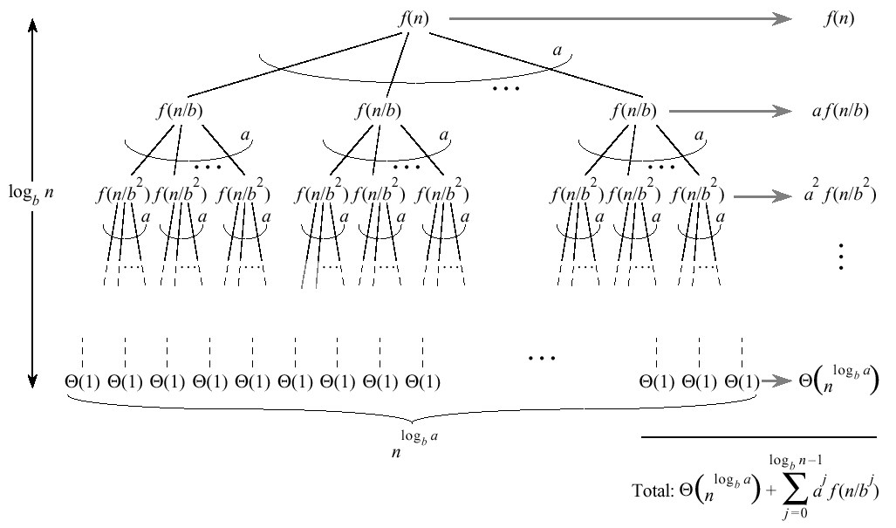


…Master Method
Split problem into a parts. There are
log_{b}n levels. There are leaves.

Slide 5
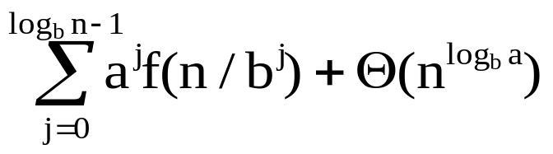
…Master Method
Iterating the recurrence (expanding the tree) yields
T(n) = f(n) + aT(n/b)
= f(n) + af(n/b) + a²T(n/b²)
= f(n) + af(n/b) + a²f(n/b²) + …
a^{log}b^{n-1}f(n/b^{log}b^{n-1}) + a^{log}b^{n}T(1)
T(n) =
The first term is a division/recombination cost (totaled across all levels of the tree).
The second term is the cost of doing all subproblems of size 1 (total of all work pushed to leaves).

Slide 6

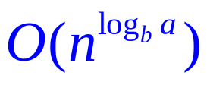
Master Method, Intuition
Three common cases:
  Running time dominated by cost at leaves.
  Running time evenly distributed throughout the tree.
  Running time dominated by cost at the root.
To solve the recurrence, we need to identify the dominant term.
In each case compare with

Slide 7
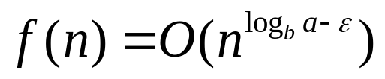

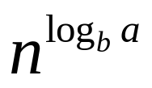
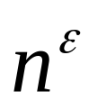
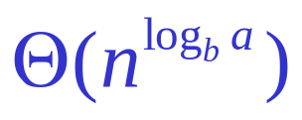
Master Method, Case 1
If for some constant then
  f(n) grows polynomially slower than (by factor ).
The work at the leaf level dominates
  Cost of all the leaves

Slide 8
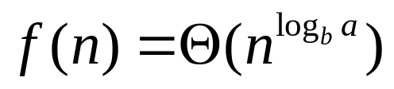
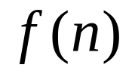
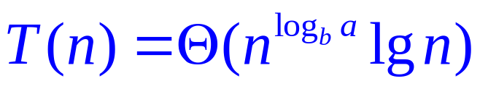
Master Method, Case 2
If then
  and are asymptotically the same
The work is distributed equally throughout the tree
      (level cost)(number of levels)

Slide 9
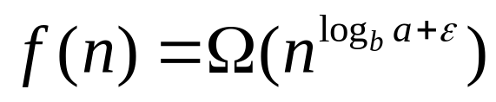
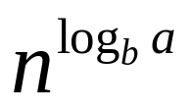

Master Method, Case 3
If for some constant then
  Inverse of Case 1
  f(n) grows polynomially faster than
  Also need a “regularity” condition
The work at the root dominates
  division/recombination cost

Slide 10
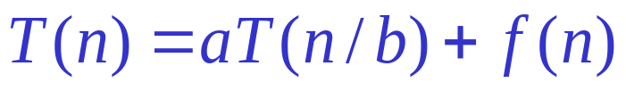
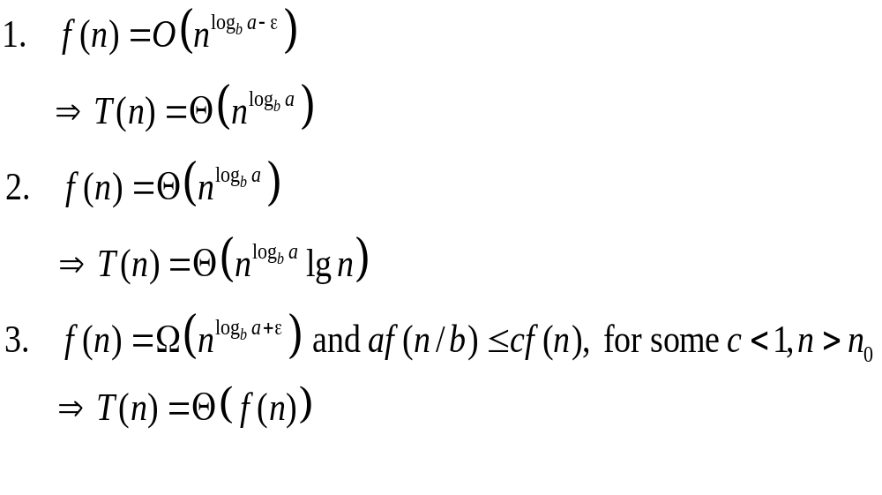
Master Theorem, Summarized
Given: recurrence of the form
This basically means is smaller than
This basically means is equal to
This basically means is greater than

Slide 11
Strategy
Extract a, b, and f(n) from a given recurrence
Determine n^{log}b ª
Compare f(n) and n^{log}b ª asymptotically
Determine appropriate Master Method case and apply it
Merge sort: T(n) = 2T(n/2) + Θ(n)
1. a=2, b=2, f(n) = Θ(n)
2. n^{log}2² = n = Θ(n)
3. f(n) = Θ(n) __________ [ So, f(n) == n^{log}2²]
➔ It matches with Case 2:
So, T(n) = Θ(n^{log}bª log n) = Θ(n log n)

Slide 12
Examples of Master Method
T(n) = T(n/2) + 1
1. a=1, b=2, f(n) = 1
2. n^{log}2¹ = 1
3. f(n) = 1 __________ [ So, f(n) == n^{log}2¹]
➔ It matches with Case 2:
So, T(n) = Θ(1 log n) = Θ(log n)

Slide 13
...Examples of Master Method
T(n) = 9T(n/3) + n
1. a=9, b=3, f(n) = n
2. n^{log}3⁹ = n²
3. f(n) = n __________ [ So, f(n) < n^{log}3⁹]
It matches with Case 1:
So, T(n) = Θ(n²)

Slide 14
...Examples of Master Method
T(n) = 3T(n/4) + n log n
1. a=3, b=4, f(n) = n log n
2. n^{log}4³ = n^{0.792}
3. f(n) = n log n __________ [ So, f(n) > n^{log}4³]
It matches with Case 3:
So, now we have to check the regularity condition in order to stateT(n)=Θ(f(n)).

Slide 15
...Examples of Master Method
Checking the regularity condition:
af(n/b) <= cf(n)
L.H.S: af(n/b) = 3(n/4)log(n/4)
R.H.S: cf(n) = (3/4)nlog n [for example, c=3/4]
L.H.S <= R.H.S
Therefore, T(n) = Θ(f(n)) = Θ(n log n)

Slide 16
References & Readings
CLRS
  Chapter: 4 (4.1-4.3)
  4.4 for bedtime reading
  Exercises
    4.1, 4.2, 4.3
  Problems
    4-1, 4-4
HSR
  Chapter: 3 (3.1-3.6)
  Examples: 3.1-3.5
  Exercises: 3.1 (1, 2), 3.2 (1, 3-6),

